Slide 1
Spark Jobs - Auto Prepare Deployments, Pre-definer
Vikash Rathore, Kavitha, Akshaya Priya, Kamakya

Slide 2
Problem Statement
As part of SDIL-ODH team we are developing complex spark job using PySpark and Code check-in for deployment
Coding involves multiple data sources and repetitive codes to be written manually
Code check-in process is also a repetitive and tedious work
Main challenges faced here are:
This manual repetitive tasks are time consuming
Chances to make mistakes or overlook some parts (ex. Optional Packages, Datatypes etc.)
Manual check-in process needs following strict guidelines and checks
Failure to comply properly results in Code quality issue and optimization problems.

Slide 3
High Level Solution design
As a solution we are going to build a single automated framework
Build an user friendly UI which will take care of Spark Job template and Automated PR/Docker creation
This UI will get all necessary inputs from user (ex. Spark Configs, Git/Docker details)
Forward the request to backend scripts to generate templates and Auto start PR/Docker creation process.
The application can be deployed in any user’s local machine
It can be scalable to accommodate other script templating and bitbucket check-ins

Slide 4
High Level Solution design
EVERY single PR needs to go through Review and approval process from ODH platform team. Our Auto prepare solution will definitely save rework and we can go with less reviews and deployment will happen quickly
Multiple reviews and rework brings down the confidence of the Prodapt team but this solution will definitely help to avoid it
This solution sets Consistent coding standard set for the team along with optimized function definitions
No dependency on the experts for development. Anyone can start development easily

Slide 5
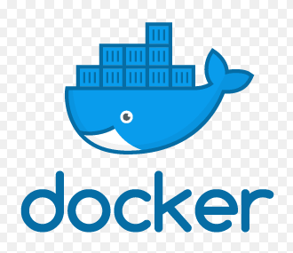
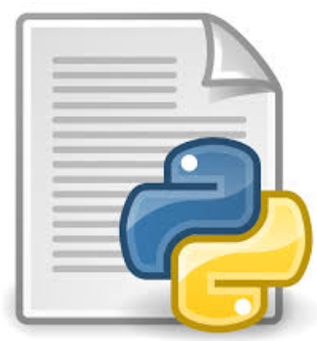


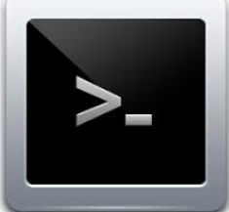


Solution Design

Slide 6
Tools Used
Tools Used | Licensing | Remarks
Git | Open Source | For PR creation
Docker | Open Source | For docker image creation
Python | Open Source | For code template generation
Ubuntu | Open Source | Used as OS and Script running platform
Node js | Open Source | Backend integration
Angular | Open Source | For end UI development
Microsoft Visual Studio Code | Community Licensing | Code development

Slide 7
Scope of Demo
In Pre-definer section, we are taking below three data pipelines to show how templates (.py and .yml) files will be generated
Kafka-Kafka
Kafka-Cassandra
Cassandra-Kafka
For Automated PR creation, we will be creating a sample PR in GitHub using all the details required from user
For Docker creation automated docker build and pushing to the repository

Slide 8
comparision
 | Without solution | With solution
complexity | High-all design analysis,design required | Less-90% of the mandatory features are taken care
Time to execute | 100% effort needed Example:10 days from design till deploy | 50% effort Example:5 days should be fair enough
errors | Everything is manual & person dependent is so high | Mandatory check aldready covered so less error rate
Rework/ reapeat cycle | Many reworks involved | Less or ideally no
Expert dependency | High skilled expertise is needed | Less,just usage of tool is just needed,basic coding skills needed

